Slide 1


SUBJECT: PYTHON FOR COMPUTATIONAL PROBLEM SOLVING (PCPS)
SUBJECT CODE: UE23CS151A
SEMESTER-I
MINI PROJECT
SNAKES & LADDERS
TEAM DETAILS:
SRIRAMA V SWAMY - PES1UG23CS598
SRIJAN JHA - PES1UG23AM316
SUMEET H TUMMARMATI - PES1UG23CS611
SURYA P - PES1UG23CS620
UNDER THE GUIDANCE OF,
MS. GAYATRI
Asst. Prof
Dept. of CSE
PES UNIVERSITY

Slide 2
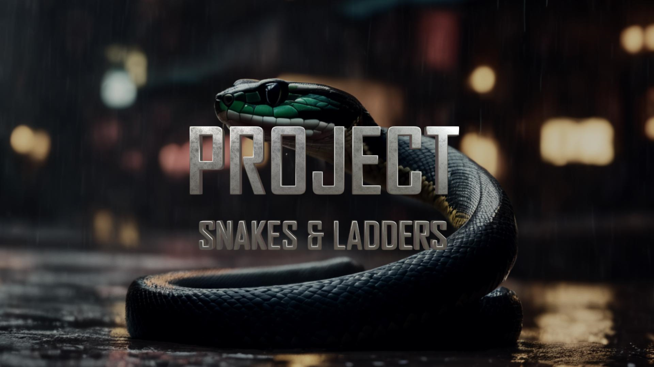
SUBJECT: PYTHON FOR COMPUTATIONAL PROBLEM SOLVING (PCPS)
SUBJECT CODE: UE23CS151A
SEMESTER-I
MINI PROJECT
SNAKES & LADDERS
TEAM DETAILS:
SRIRAMA V SWAMY - PES1UG23CS
SRIJAN JHA - PES1UG23CS
SUMEET H TUMMARMATI - PES1UG23CS
SURYA P - PES1UG23CS620
UNDER THE GUIDANCE OF,
MS. GAYATRI
Asst. Prof
Dept. of CSE
PES UNIVERSITY

Slide 3

OUTLINE
Problem Statement
Team Roles and Responsibilities.
List of inbuilt modules with its features highlighted for each
Implementation Details – Pseudocode / Algorithm
Results and Discussion – Screenshots of outputs
Learning from this project
Conclusion
Future Work
References – Textbooks/ web Links/ Any resource used as reference

Slide 4

PROBLEM STATEMENT
1. LACK OF INTERACTIVE GAMING SOLUTIONS
The absence of an engaging, user-friendly implementation of the classic Snakes and Ladders game using Python with a graphical user interface presented a challenge. Existing solutions were either non-interactive or lacked intuitive interfaces.
2. EDUCATIONAL AND DEVELOPMENTAL OBJECTIVES
The project aimed to bridge the gap between theoretical programming knowledge and practical application. Creating a game served as a platform to reinforce Python programming skills and delve into GUI development while exploring game logic.
3. EXPLORATION OF PYTHON LIBRARIES
Utilizing Python's capabilities, including GUI libraries like Tkinter or Pygame, was a key objective. This involved understanding and implementing these tools to craft a seamless user experience within the game.
4.BRIDGING PRACTICAL APPLICATIONS
Lastly, the project aimed to demonstrate the practical applications of Python programming beyond theoretical concepts, showcasing its potential in developing interactive and entertaining applications.

Slide 5
PROBLEM STATEMENT
1. LACK OF INTERACTIVE GAMING SOLUTIONS
The absence of an engaging, user-friendly implementation of the classic Snakes and Ladders game using Python with a graphical user interface presented a challenge. Existing solutions were either non-interactive or lacked intuitive interfaces.
2. EDUCATIONAL AND DEVELOPMENTAL OBJECTIVES
The project aimed to bridge the gap between theoretical programming knowledge and practical application. Creating a game served as a platform to reinforce Python programming skills and delve into GUI development while exploring game logic.
3. EXPLORATION OF PYTHON LIBRARIES
Utilizing Python's capabilities, including GUI libraries like Tkinter or Pygame, was a key objective. This involved understanding and implementing these tools to craft a seamless user experience within the game.
4.BRIDGING PRACTICAL APPLICATIONS
Lastly, the project aimed to demonstrate the practical applications of Python programming beyond theoretical concepts, showcasing its potential in developing interactive and entertaining applications.

Slide 6
TEAM ROLES AND RESPONSIBILITIES
SRIRAMA: He has been tasked with analyzing the game and writing the pseudocode and logic for the final coding. He has been a pivotal figure in delegating work.
SURYA: He has been tasked with writing part of the final codes as well as impacting the overall design and formatting of the demo PowerPoint presentation.
SUMEET: He has been tasked with analysis and pseudocode writing, as well as making the word document for the project.
SRIJAN: He has been tasked with adding content and media to the PowerPoint presentation, as well as writing part of the final code.

Slide 7
TEAM ROLES AND RESPONSIBILITIES
SRIRAMA: He has been tasked with analyzing the game and writing the pseudocode and logic for the final coding. He has been a pivotal figure in delegating work.
SURYA: He has been tasked with writing part of the final codes as well as impacting the overall design and formatting of the demo PowerPoint presentation.
SUMEET: He has been tasked with analysis and pseudocode writing, as well as making the word document for the project.
SRIJAN: He has been tasked with adding content and media to the PowerPoint presentation, as well as writing part of the final code.

Slide 8
LIST OF INBUILT MODULES WITH ITS FEATURES HIGHLIGHTED FOR EACH
dicemod.py – mimics rolling of dice
gotimovement.py – controls motion of player
graphics.py – imports graphics
laddercheck.py – ladder function
mousepos.py – check mouse position
muteunmute.py – mutes and unmutes audio
snakecheck.py – snake function
snake n ladder.py – main game controls
pygame.py – imports pygame module
random.py – imports random module
time.py – imports time module

Slide 9
LIST OF INBUILT MODULES WITH ITS FEATURES HIGHLIGHTED FOR EACH

Slide 10
IMPLEMENTATION DETAILS – PSEUDOCODE / ALGORITHM
# Function to roll the dice and move the player function
roll_dice_and_move(player_position):
roll_dice()
player_position += dice_result
check_snake_or_ladder(player_position)
# Function to check for snakes or ladders Function
check_snake_or_ladder(player_position):
# Check if the player landed on a snake or ladder and adjust position
# Function to check if a player has won function check_win(player_position):
# Check if the player has reached or passed the last position and declare a winner
# Initialize players
player1_position = 1
player2_position = 1
# Main game loop
while True:
# Player 1's turn
roll_dice_and_move(player1_position)
check_win(player1_position)
# Player 2's turn
roll_dice_and_move(player2_position)
check_win(player2_position)

Slide 11
IMPLEMENTATION DETAILS – PSEUDOCODE / ALGORITHM
# Function to roll the dice and move the player function
roll_dice_and_move(player_position):
roll_dice()
player_position += dice_result
check_snake_or_ladder(player_position)
# Function to check for snakes or ladders Function
check_snake_or_ladder(player_position):
# Check if the player landed on a snake or ladder and adjust position
# Function to check if a player has won function check_win(player_position):
# Check if the player has reached or passed the last position and declare a winner
# Initialize players
player1_position = 1
player2_position = 1
# Main game loop
while True:
# Player 1's turn
roll_dice_and_move(player1_position)
check_win(player1_position)
# Player 2's turn
roll_dice_and_move(player2_position)
check_win(player2_position)

Slide 12
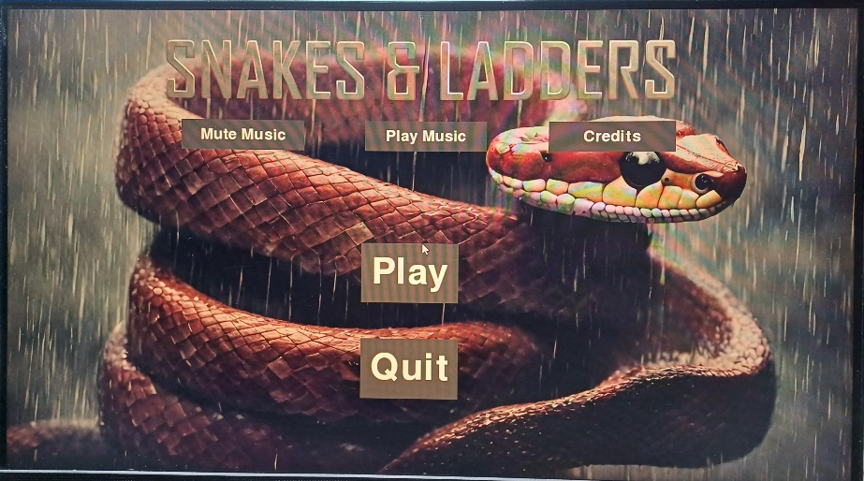
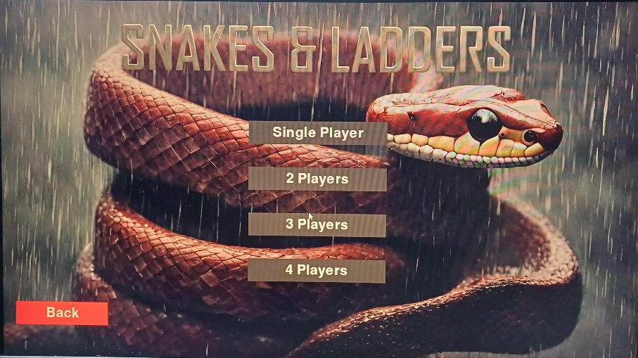
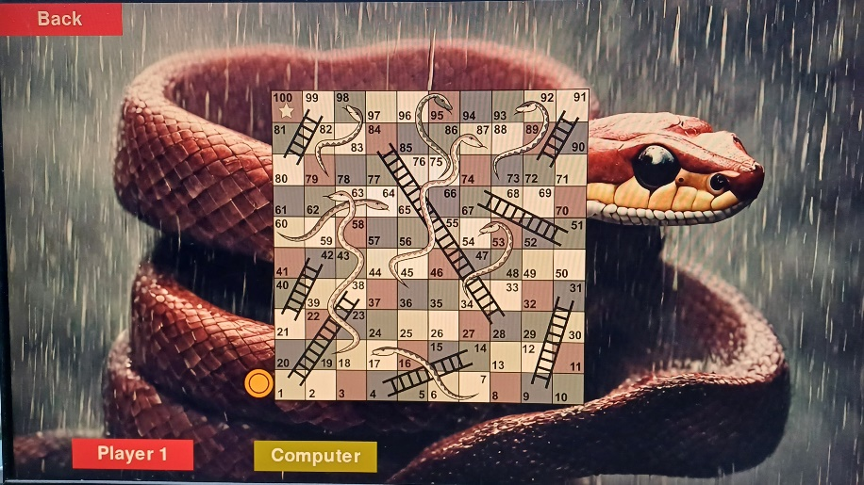
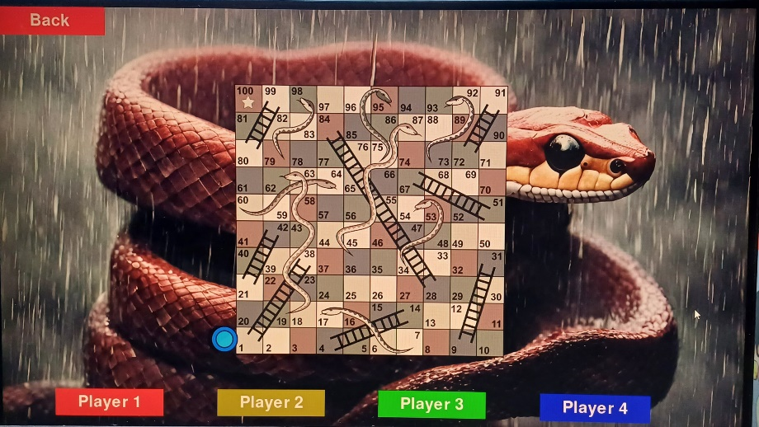
RESULTS AND DISCUSSION – SCREENSHOTS OF OUTPUTS

Slide 13
RESULTS AND DISCUSSION – SCREENSHOTS OF OUTPUTS

Slide 14
LEARNING FROM THIS PROJECT
1. PROFICIENCY IN PYTHON
Developing this Snakes and Ladders game significantly honed Python programming skills. From fundamental syntax to advanced concepts like object-oriented programming, the project offered a comprehensive learning experience.
2. GUI DEVELOPMENT
Exploring GUI libraries in Python, such as Tkinter or PyGame, provided valuable exposure to building interactive interfaces. Understanding layout management, event handling, and widget implementation were pivotal in creating a user-friendly game environment.
3. PROBLEM-SOLVING SKILLS
Encountering and resolving coding challenges fostered a problem-solving mindset. From debugging game logic to refining graphical elements, each hurdle served as an opportunity for growth and skill refinement.
4. PROJECT MANAGEMENT
Managing the project lifecycle—planning, development, testing, and iteration—highlighted the importance of structured workflows. This encompassed task prioritization, time management, and iterative development to achieve project goals effectively.

Slide 15
LEARNING FROM THIS PROJECT
1. PROFICIENCY IN PYTHON
Developing this Snakes and Ladders game significantly honed Python programming skills. From fundamental syntax to advanced concepts like object-oriented programming, the project offered a comprehensive learning experience.
2. GUI DEVELOPMENT
Exploring GUI libraries in Python, such as Tkinter or Pygame, provided valuable exposure to building interactive interfaces. Understanding layout management, event handling, and widget implementation were pivotal in creating a user-friendly game environment.
3. PROBLEM-SOLVING SKILLS
Encountering and resolving coding challenges fostered a problem-solving mindset. From debugging game logic to refining graphical elements, each hurdle served as an opportunity for growth and skill refinement.
4. PROJECT MANAGEMENT
Managing the project lifecycle—planning, development, testing, and iteration—highlighted the importance of structured workflows. This encompassed task prioritization, time management, and iterative development to achieve project goals effectively.

Slide 16
CONCLUSION
1. SUCCESSFUL IMPLEMENTATION
The successful development of this game underscores the power and versatility of Python in creating interactive and engaging applications. The integration of GUI elements has facilitated a user-friendly experience.
2. LEARNING AND GROWTH
Throughout this project, a myriad of lessons emerged, from refining coding skills in Python to understanding the nuances of GUI development. The process offered invaluable insights into problem-solving and project management.
3. OVERCOMING CHALLENGES
Addressing hurdles in game logic, graphical rendering, and user interaction enhanced adaptability and resourcefulness.
4. REAL-WORLD APPLICATIONS
The acquired knowledge and skills hold relevance in diverse fields, ranging from software development to problem-solving scenarios.
5. FUTURE EVOLUTION
Expanding features, incorporating AI opponents, and refining the GUI could further elevate the gaming experience.

Slide 17
CONCLUSION
1. SUCCESSFUL IMPLEMENTATION
The successful development of this game underscores the power and versatility of Python in creating interactive and engaging applications. The integration of GUI elements has facilitated a user-friendly experience.
2. LEARNING AND GROWTH
Throughout this project, a myriad of lessons emerged, from refining coding skills in Python to understanding the nuances of GUI development. The process offered invaluable insights into problem-solving and project management.
3. OVERCOMING CHALLENGES
Addressing hurdles in game logic, graphical rendering, and user interaction enhanced adaptability and resourcefulness.
4. REAL-WORLD APPLICATIONS
The acquired knowledge and skills hold relevance in diverse fields, ranging from software development to problem-solving scenarios.
5. FUTURE EVOLUTION
Expanding features, incorporating AI opponents, and refining the GUI could further elevate the gaming experience.

Slide 18
FUTURE WORK
ENHANCED USER INTERFACE: Explore more interactive and visually appealing design elements for the game interface, such as animated graphics or custom-designed game boards.
MULTIPLAYER FUNCTIONALITY: Implement a multiplayer mode allowing multiple players to participate simultaneously, either locally or over a network.
AI OPPONENTS: Introduce an artificial intelligence component to allow players to compete against computer-controlled opponents with varying levels of difficulty.
CUSTOMIZATION OPTIONS: Provide options for players to customize the game board, themes, or even create their own custom boards.
STATISTICS AND LEADERBOARDS: Include a feature that tracks and displays game statistics, such as win-loss records, average game duration, or high scores. You could also add a leaderboard to showcase top players.

Slide 19
FUTURE WORK
ENHANCED USER INTERFACE: Explore more interactive and visually appealing design elements for the game interface, such as animated graphics or custom-designed game boards.
MULTIPLAYER FUNCTIONALITY: Implement a multiplayer mode allowing multiple players to participate simultaneously, either locally or over a network.
AI OPPONENTS: Introduce an artificial intelligence component to allow players to compete against computer-controlled opponents with varying levels of difficulty.
CUSTOMIZATION OPTIONS: Provide options for players to customize the game board, themes, or even create their own custom boards.
STATISTICS AND LEADERBOARDS: Include a feature that tracks and displays game statistics, such as win-loss records, average game duration, or high scores. You could also add a leaderboard to showcase top players.

Slide 20
FUTURE WORK
SOUND EFFECTS AND MUSIC: Incorporate sound effects or background music to enhance the gaming experience.
MOBILE COMPATIBILITY: Adapt the game for mobile devices, ensuring responsiveness and compatibility across various screen sizes.
REFINEMENT OF GAME MECHANICS: Continuously refine and optimize the game mechanics for smoother gameplay and a more enjoyable user experience.

Slide 21
FUTURE WORK
SOUND EFFECTS AND MUSIC: Incorporate sound effects or background music to enhance the gaming experience.
MOBILE COMPATIBILITY: Adapt the game for mobile devices, ensuring responsiveness and compatibility across various screen sizes.
REFINEMENT OF GAME MECHANICS: Continuously refine and optimize the game mechanics for smoother gameplay and a more enjoyable user experience.

Slide 22
REFERENCES
PYTHON KNOWLEDGE AND PRE-REQUISITES
https://www.sourcecodester.com/download-code?nid=14706&title=Snake+and+Ladder+Game+using+Pygame+with+Source+Code
https://www.geeksforgeeks.org/snake-ladder-problem-2/

Slide 23
REFERENCES
PYTHON KNOWLEDGE AND PRE-REQUISITES
https://www.sourcecodester.com/download-code?nid=14706&title=Snake+and+Ladder+Game+using+Pygame+with+Source+Code
https://www.geeksforgeeks.org/snake-ladder-problem-2/

Slide 24
THANK YOU TEAM 7

Slide 25
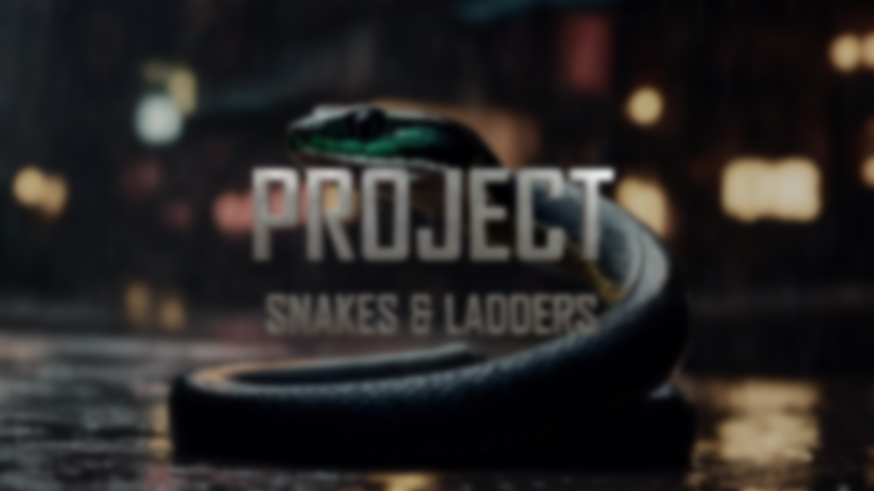
THANK YOU TEAM 7

